Slide 1
Systems of Linear Equations 4: Error and Condition Number
AMSC/CMSC 460
Dr. Christopher Moakler

Slide 2
Review from last lecture
Direct methods can give us exact solutions if we are able to have infinite precision in our matrices.
Computers are unable to do this so we can only hope for approximate solutions at best.
Direct methods work well on small and medium sized matrices (up to hundreds of thousands of equations) but are not feasible for larger systems.
To solve these systems, we instead use iterative methods.
We looked at three variations of an overarching method that breaks the coefficient matrix into an easily invertible matrix, M, and a “remainder” matrix, N.

Slide 3
Review from last lecture contd
These three methods were:
Jacobi Method: M = D, N = L + U
Gauss-Seidel: M = (D + L) and N = U.
Successive Over-Relaxation: $M=\frac{1}{ω}D+L$ and $N=\frac{1−ω}{ω}D+U$
The Gauss-Seidel method is essentially the Jacobi method but used the most up to date values without waiting for the full iteration to complete.
SOR is essentially the Gauss-Seidel method but with a weighting factor to force the solution to converge more quickly.
All of these methods often have faster convergence than direct methods and are especially effective when solving sparse matrices.
Though really only Jacobi takes advantage of the sparsity.

Slide 4
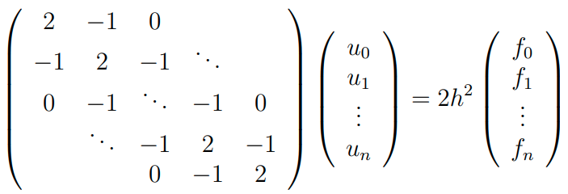
Review from last lecture contd
These methods can also be applied to solve partial differential equations.
In that application, the matrices required are often tri-diagonal and these methods are especially effective.
For example, the two-dimensional Poisson problem, $−\frac{d^{2}u}{dx^{2}}=f(x)$ can be discretized as, $\frac{d^{2}u}{dx^{2}}{\left.​\right|}_{x=x_{j}}= \frac{u_{j−1 }+u_{j+1}−2u_{j} }{2h^{2}}$, where h is some small number.
You typically take $h=\frac{2}{N}$, which results in the linear system,

Slide 5
Sources of error in Gaussian Elimination
There are two main sources of error in Gaussian Elimination
Ill conditioned matrices
Swamping
Swamping is an issue for which we already have a solution, partial pivoting.
Ill-conditioning is a problem which we have seen before and there is no real way to overcome this problem.

Slide 6
Swamping
Consider the system of equations represented with the following matrix equation
$$\left[\begin{matrix}{10}^{−20} & 1 \\ 1 & 2\end{matrix}\right]\left[\begin{matrix}x_{1} \\ x_{2}\end{matrix}\right]=\left[\begin{matrix}1 \\ 4\end{matrix}\right]$$
Solving this system by hand is a simple matter.
We put it in row echelon form
$$\left[\begin{matrix}{10}^{−20} & 1 \\ 0 & 2−{10}^{20}\end{matrix}\right]\left[\begin{matrix}x_{1} \\ x_{2}\end{matrix}\right]=\left[\begin{matrix}1 \\ 4−{10}^{20}\end{matrix}\right]$$
Solving this with forward substation gives us the exact solution
$$x=\left[\begin{matrix}\frac{2×{10}^{20}}{{10}^{20}−2} \\ \frac{4−{10}^{20}}{2−{10}^{20}}\end{matrix}\right]$$
This is very nearly equal to [2,1].

Slide 7
Swamping Contd
This works just fine if we have “infinite memory” as we do when doing hand computations.
However, once we switch to using computers, we lose our infinite memory and run into serious issues.
Let’s look again at the row echelon form
$$\left[\begin{matrix}{10}^{−20} & 1 \\ 0 & 2−{10}^{20}\end{matrix}\right]\left[\begin{matrix}x_{1} \\ x_{2}\end{matrix}\right]=\left[\begin{matrix}1 \\ 4−{10}^{20}\end{matrix}\right]$$
What’s the issue here?
What problem do we have when using a computer?

Slide 8
Swamping Contd
The problem is in the term $2−{10}^{20}$.
In IEEE double precision, this rounds to simply ${−10}^{20}$.
We also have the same problem with $4−{10}^{20}$ which also rounds to ${−10}^{20}$
This is a huge problem!
The new matrix becomes
$$\left[\begin{matrix}{10}^{−20} & 1 \\ 0 & −{10}^{20}\end{matrix}\right]\left[\begin{matrix}x_{1} \\ x_{2}\end{matrix}\right]=\left[\begin{matrix}1 \\ −{10}^{20}\end{matrix}\right]$$
The solution to this system is now $x=[\begin{matrix}0 \\ 1\end{matrix}]$.

Slide 9
Partial Pivoting to the rescue!
If we instead exchange rows 1 and 2, we overcome the issue of swamping and get a very accurate solution.
$$\left[\begin{matrix}1 & 2 \\ {10}^{−20} & 1\end{matrix}\right]\left[\begin{matrix}x_{1} \\ x_{2}\end{matrix}\right]=\left[\begin{matrix}4 \\ 1\end{matrix}\right]$$
We now multiply by ${10}^{−20}$ instead of ${10}^{20}$.
$$\left[\begin{matrix}1 & 2 \\ 0 & 1−2×{10}^{−20}\end{matrix}\right]\left[\begin{matrix}x_{1} \\ x_{2}\end{matrix}\right]=\left[\begin{matrix}4 \\ 1−4×{10}^{−20}\end{matrix}\right]$$
With double precision the matrix equation becomes
$$\left[\begin{matrix}1 & 2 \\ 0 & 1\end{matrix}\right]\left[\begin{matrix}x_{1} \\ x_{2}\end{matrix}\right]=\left[\begin{matrix}4 \\ 1\end{matrix}\right]$$
The solution of which is $x=\left[\begin{matrix}2 \\ 1\end{matrix}\right]$
This is not the exact solution, but it is accurate up to about 16 decimal places.

Slide 10
Matrix Norms
To discuss the condition number of a matrix we will need the concept of a matrix norm.
A matrix norm is… well a norm for matrices.
A norm for scalars is simply the magnitude of a scalar
|-3| = 3
|2| = 2
There are several norms for vectors
${\left|\left|x\right|\right|}_{1}=\sum{{|x}_{i}|}$ (1-norm) induces the taxicab or Manhattan metric
${\left|\left|x\right|\right|}_{2}={\left(\sum{x_{i}^{2}}\right)}^{\frac{1}{2}}$ (Euclidean norm) induces the Euclidean
${\left|\left|x\right|\right|}_{∞}=\max\left(\left|x_{i}\right|\right)$ (Infinity-norm) induces the Chebyshev or chessboard metric

Slide 11
Matrix Norms contd
There are also multiple ways to define a matrix norm.
Here are two common examples:
${\left|\left|A\right|\right|}_{1}=\max\left(\sum_{i=1}^{n}{{|a}_{ij}|}\right)$ (Maximum absolute column sum)
${\left|\left|A\right|\right|}_{∞}=\max\left(\sum_{j=1}^{n}{{|a}_{ij}|}\right)$ (Maximum absolute row sum)
${\left|\left|A\right|\right|}_{2}=σ_{max}(A)$(Maximum singular value of A)

Slide 12
Condition Number for Matrix Inversion
The condition number is a measure of how sensitive the problem is to small perturbations of the elements.
We have been looking at equations of the form
$$Ax = b$$
If we perturb the solution x we can write the system as
$$A(x+dx) =b + db$$
Subtracting these two equations gives us
$$Adx = db$$
Which we can solve as
$$dx = A^{−1}db$$

Slide 13
Condition Number Contd
For the original system Ax = b we can take the norm of both sides
$$||b||≤\left|\left|A\right|\right|\left|\left|x\right|\right|$$
For $δx=A^{−1}δb$ we have
$$||δx||≤\left|\left|A^{−1}\right|\right|\left|\left|δb\right|\right|$$
Let’s multiply these two and get
$$\left|\left|b\right|\right| \left|\left|δx\right|\right|≤\left|\left|A\right|\right| \left|\left|x\right|\right| \left|\left|A^{−1}\right|\right| \left|\left|δb\right|\right|$$
Let’s divide by $\left|\left|b\right|\right| \left|\left|x\right|\right|$and get
$$\frac{\left|\left|δx\right|\right|}{|\left|x\right||}≤\left|\left|A\right|\right| \left|\left|A^{−1}\right|\right|\frac{\left|\left|δb\right|\right|}{|\left|b\right||}$$
We identify the term $\left|\left|A\right|\right| \left|\left|A^{−1}\right|\right|$ as the condition number of the matrix A.
Why?

Slide 14
Condition Number Contd
The equation,
$\frac{\left|\left|δx\right|\right|}{|\left|x\right||}≤\left|\left|A\right|\right| \left|\left|A^{−1}\right|\right|\frac{\left|\left|δb\right|\right|}{|\left|b\right||}$
tells us how sensitive the solution x is to changes in the RHS vector b.
A similar analysis also tells us how the solution vector changes when the matrix itself is perturbed.
The equation comes out to be
$\frac{\left|\left|δx\right|\right|}{|\left|x+δx\right||}≤\left|\left|A\right|\right| \left|\left|A^{−1}\right|\right|\frac{\left|\left|δA\right|\right|}{|\left|A\right||}$

Slide 15
Conditioning of a Matrix
If the condition number is not too much larger than 1, the matrix is said to be well-conditioned and small changes to the matrix A will not affect the solution too much.
If the condition number is very large, the matrix is said to be ill-conditioned.
If the condition number is infinite, the matrix is non-invertible and the system is ill-posed.
This is a problem inherent to the matrix, or system, itself and can not be overcome with computational techniques or a different algorithm.

Slide 16
What is a Condition Number?
The previous discussion was in reference to the condition number associated with matrix inversion.
By extension, this is also the condition number for solving a linear system.
There are other condition numbers for other “problems”
In general, the condition number is a measure of how sensitive the “problem” is to small perturbations to the input.
The “problem” might be matrix inversion, finding eigenvalues, or just adding two numbers.

Slide 17
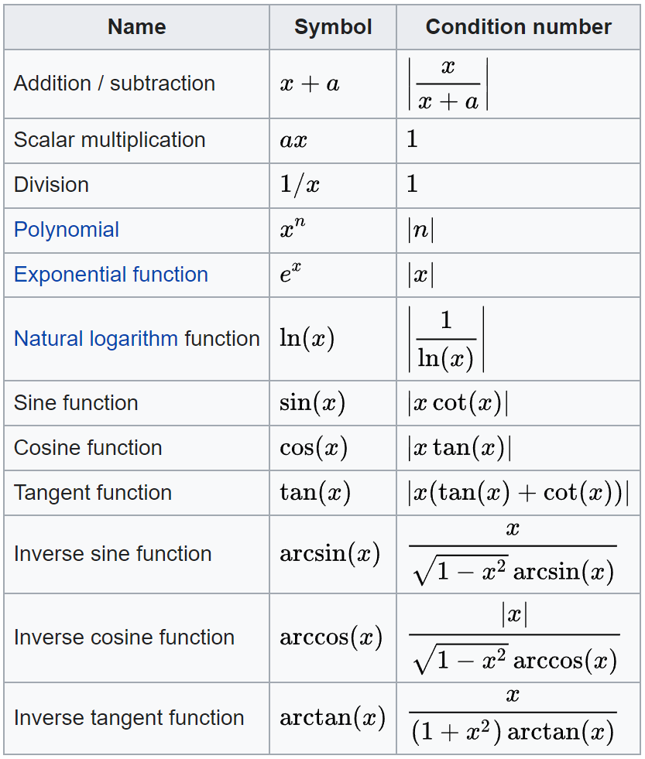
Other Condition Numbers
These are used to determine the number of sig figs when doing computations.
https://en.wikipedia.org/wiki/Condition_number#:~:text=The%20condition%20number%20is%20an,the%20data%20in%20the%20problem.

Slide 18
Eigenvalue Condition Number
The condition number for finding eigenvalues is given by,
$$κ_{λ}\left(A\right)=\frac{{\left|\left|x\right|\right|}_{2}{\left|\left|y\right|\right|}_{2}}{|x⋅y|}$$
Where $x$ and $y$ are the right and left eigenvectors of $A$ associated with the same eigenvalue.
Note, a matrix that is well-conditioned for matrix inversion might be ill-conditioned for finding eigenvalues or vice versa.

